Slide 1
The science of hot air balloons

Slide 2
Questions to answer
What is a hot air balloon?
What are the mechanisms that make hot air balloon float in air?
What is buoyant force?
What causes the buoyant force of the a hot air balloon?

Slide 3
Short video
https://www.youtube.com/watch?v=AqhnZz17amw

Slide 4
What is a hot air balloon?
https://forms.office.com/Pages/ResponsePage.aspx?id=f483B8E1xUKE2zn8anoyG5gGCu5Z09dFm7VyclTxHLNURFFFUDVDM1pOVTM0WDZFOFFWQ1Y1N1k3VC4u

Slide 5
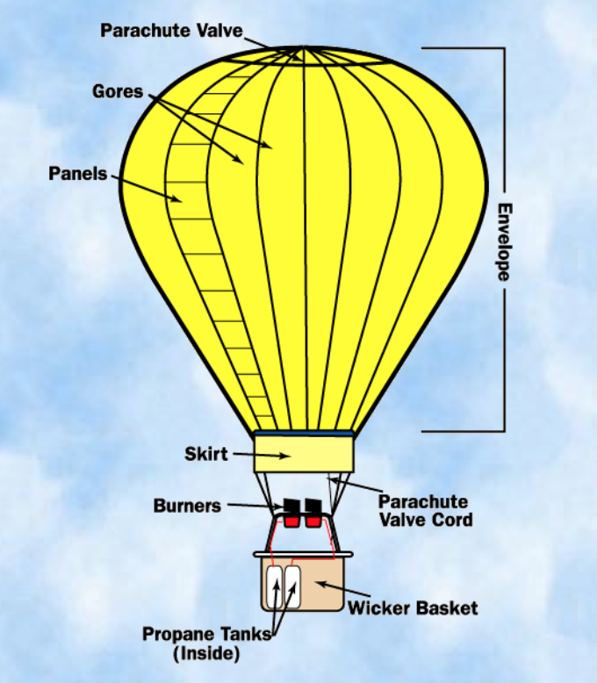
What is a hot air balloon?

Slide 6
How does a hot air balloon floats?
https://forms.office.com/Pages/ResponsePage.aspx?id=f483B8E1xUKE2zn8anoyG5gGCu5Z09dFm7VyclTxHLNUQjBFNkdOMFZaQThWMDBPTEtaSkU2ME5aOS4u

Slide 7
What is a buoyant force?
https://www.youtube.com/watch?v=16HDJNoXQII

Slide 8
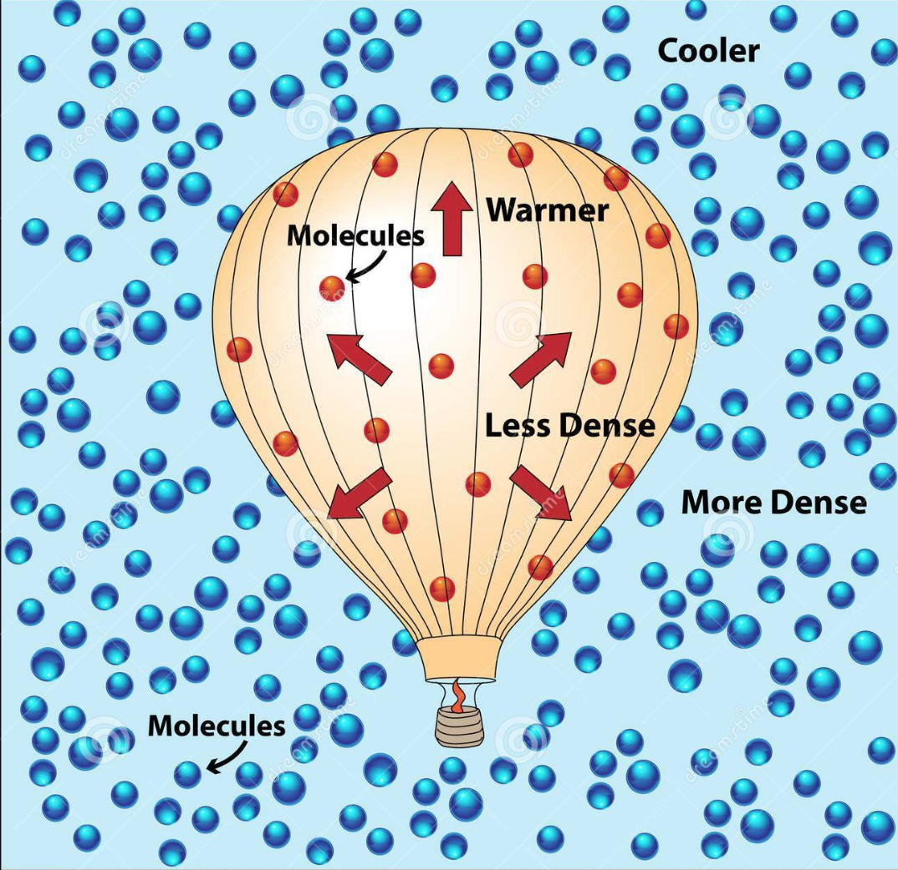
How does a hot air balloon floats?

Slide 9
Individual experiment
Create a parachute that could carry a piece of egg.
Launch it at a certain height (e.g approximately 3 meters above the ground.
Devise a mathematical method to calculate the buoyant force that opposes the force of gravity as you allow your parachute with the egg to drop.
Determine and indicate the important quantities necessary to calculate the buoyant force.
Submit draft report on 15 June 2020. (A link in the moodle will be provided.

Slide 10
http://ffden-2.phys.uaf.edu/webproj/212_spring_2014/Jaimie_Barnes/Jaimie_Barnes/Parts.html

